Slide 1

Graphs and Trees
Mathematical Structures for Computer Science
Chapter 6
Copyright © 2014 W.H. Freeman & Co. MSCS Slides Section 6.2

Slide 2
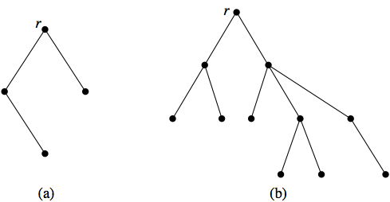
Tree Terminology
A special type of graph called a tree turns out to be a very useful representation of data.
DEFINITION: TREE A tree is an acyclic, connected graph with one node designated as the root of the tree.
Section 6.2
Trees and Their Representations

Slide 3
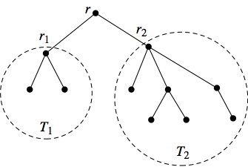
Defining Trees Recursively
A tree can also be defined recursively.
  A single node is a tree (with that node as its root).
  If T₁, T₂, ... , T_{t} are disjoint trees with roots r₁, r₂, ... , r_{t}, the graph formed by attaching a new node r by a single arc to each of r₁, r₂, ... , r_{t} is a tree with root r.
  The nodes r₁, r₂, ... , r_{t} are children of r, and r is a parent of r₁, r₂, ... , r_{t}.
Section 6.2
Trees and Their Representations

Slide 4
Tree Terminology
The depth of a node in a tree is the length of the path from the root to the node; the root itself has depth 0.
The depth (height) of the tree is the maximum depth of any node in the tree; in other words, it is the length of the longest path from the root to any node.
A node with no children is called a leaf of the tree.
All non-leaves are internal nodes.
A forest is an acyclic graph (not necessarily connected).
Section 6.2
Trees and Their Representations

Slide 5
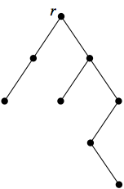
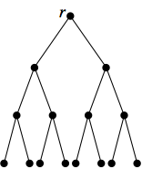
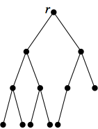
Tree Terminology
Binary trees are those where each node has at most two children.
Each child of a node is designated as either the left child or the right child.
A full binary tree (as seen in the middle figure below) occurs when all internal nodes have two children and all leaves are at the same depth.
A complete binary tree (as seen in the right figure below) is an almost-full binary tree; the bottom level of the tree is filling from left to right but may not have its full complement of leaves.
Section 6.2
Trees and Their Representations

Slide 6
Applications of Trees
Decision trees were used to solve counting problems in Chapter 4.
By using trees, a collection of records can be efficiently searched to locate a particular record or to determine that a record is not in the collection.
Files and folders stored on a computer are organized in a hierarchical (treelike) structure.
Algebraic expressions involving binary operations can be represented by labeled binary trees.
Section 6.2
Trees and Their Representations

Slide 7
Binary Tree Representation
Because a tree is also a graph, representations for graphs in general can also be used for trees.
Binary trees, however, have special characteristics that we want to capture in the representation, namely, the identity of the left and right child.
The equivalent of an adjacency matrix is a two-column array (or an array of records) where the data for each node is the left and right child of that node.
The equivalent of the adjacency list representation is a collection of records with three fields containing, respectively, the current node, a pointer to the record for the left-child node, and a pointer to the record for the right-child node.
Section 6.2
Trees and Their Representations

Slide 8
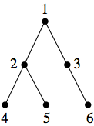
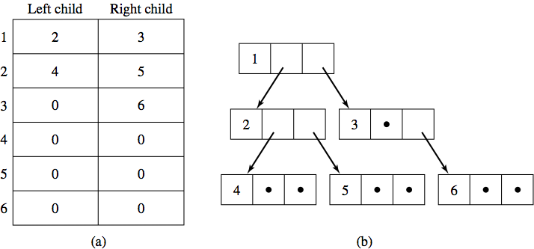
Binary Tree Representation Example
The tree represented by the figure above has the following adjacency list and adjacency matrix representations.
Section 6.2
Trees and Their Representations

Slide 9
Tree Traversal Algorithms
If a tree structure is being used to store data, it is often helpful to have a systematic mechanism for writing out the data values stored at all the nodes.
This can be accomplished by traversing the tree, that is, visiting each of the nodes in the tree structure.
The three common tree traversal algorithms are preorder, inorder, and postorder traversal.
The terms preorder, inorder, and postorder refer to the order in which the root of a tree is visited compared to the subtree nodes.
Section 6.2
Trees and Their Representations

Slide 10
Tree Traversal Algorithms
In preorder traversal, the root of the tree is visited first and then the subtrees are processed left to right, each in preorder.
ALGORITHM Preorder
Preorder(tree T)
//Writes the nodes of a tree with root r in preorder
write(r)
for i = 1 to t do
Preorder(T_{i})
end for
end Preorder
Section 6.2
Trees and Their Representations

Slide 11
Tree Traversal Algorithms
In inorder traversal, the left subtree is processed by an inorder traversal, then the root is visited, and then the remaining subtrees are processed from left to right, each in inorder. If the tree is binary, the result is that the root is visited between processing of the two subtrees.
ALGORITHM Inorder
Inorder(tree T )
//Writes the nodes of a tree with root r in inorder
Inorder(T₁)
write(r)
for i = 2 to t do
Inorder(T_{i})
end for
end Inorder
Section 6.2
Trees and Their Representations

Slide 12
Tree Traversal Algorithms
In postorder traversal, the root is visited last, after all subtrees have been processed from left to right in postorder.
ALGORITHM Postorder
Postorder(tree T )
//Writes the nodes of a tree with root r in postorder
for i = 1 to t do
Postorder(T_{i})
end for
write(r)
end Postorder
Section 6.2
Trees and Their Representations

Slide 13
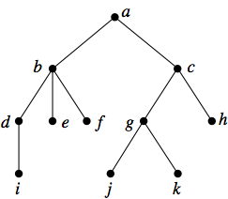
Tree Traversal Algorithms Example
What is the preorder, inorder, and postorder traversal for the following tree?
The preorder (root, left, right) traversal produces: a, b, d, i, e, f, c, g, j, k, h
The inorder (left, root, right) traversal produces: i, d, b, e, f, a, j, g, k, c, h
The postorder (left, right, root) traversal produces: i, d, e, f, b, j, k, g, h, c, a
Section 6.2
Trees and Their Representations

Slide 14
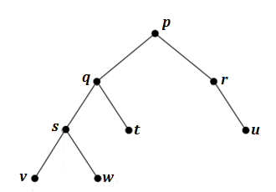
Class Exercise
Find the preorder, inorder, and postorder traversal for the following tree:
Preorder: p, q, s, v, w, t, r, u
Inorder: v, s, w, q, t, p, r, u
Postorder: v, w, s, t, q, u, r, p
Section 5.2
Trees and Their Representations

Slide 15
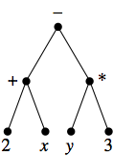
Infix Notation
The binary tree in the figure below represents the algebraic expression (2 + x) − (y * 3).
  If we do an inorder traversal of the expression tree, we retrieve the original algebraic expression.
Parentheses are added as we complete the processing of a subtree.
This is called infix notation.
Section 6.2
Trees and Their Representations

Slide 16
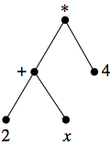
Polish Notation
A preorder traversal of a tree as seen in this figure gives the expression
* + 2 x 4.
Here the operation symbol precedes its operands.
This form of an expression is called prefix notation, or Polish notation.
The expression can be translated into infix form as follows:
* + 2 x 4 → * (2 + x) 4 → (2 + x ) * 4
Section 6.2
Trees and Their Representations

Slide 17
Class Exercise
Evaluate the Polish Notation (preorder) expression:
* - * ^ 2 3 5 6 2 = ?
* - * ^ 2 3 5 6 2 → * - * 2³ 5 6 2
* - * 2³ 5 6 2 → * - (2³ * 5) 6 2
*- (2³ * 5) 6 2 → * [(2³ * 5) – 6] 2
* [(2³ * 5) – 6] 2 → [(2³ * 5) – 6] * 2
[(2³ * 5) – 6] * 2 = 68
Section 6.2
Trees and Their Representations

Slide 18
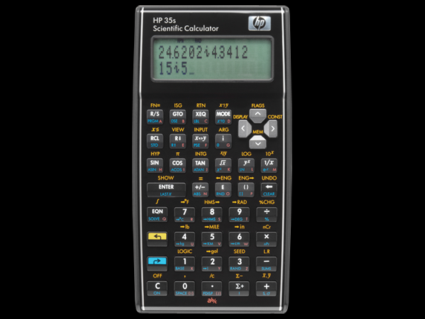
Polish Notation
A postorder traversal gives the expression 2 x + 4 *, where the operation symbol follows its operands.
This form of an expression is called postfix notation, or reverse Polish notation (or just RPN).
The expression can be translated into infix form as follows:
2 x + 4 * → (2 + x) 4 * → (2 + x) * 4
Neither prefix nor postfix form requires parentheses to avoid ambiguity
_{Click Picture}
Section 6.2
Trees and Their Representations

Slide 19
Class Exercise
Evaluate the following Reverse Polish Notation Expression
2 3 – 5 + 2 ^ 7 x → ?
2 3 – 5 + 2 ^ 7 x → (2-3) 5 + 2 ^ 7 x
(2 - 3) 5 + 2 ^ 7 x → [(2 - 3) + 5] 2 ^ 7 x
[(2 - 3) + 5] 2 ^ 7 x → [(2 - 3) + 5]² 7 x
[(2 - 3) + 5]² 7 x → [(2 - 3) + 5]² x 7
[(2 - 3) + 5]² x 7 = 112
Using a RPN calculator you would key in: “2” “3” “-” “5” “+” “2” “^” “7” “x” then hit “=“
How simple is that!
Compare this to keying in the Infix Notation
Section 6.2
Trees and Their Representations

